Slide 1
BSBCTR611 Applying critical thinking

Slide 2

Business Overview

Slide 3

The company is Worlducation. This is a social startup founded in 2016 that aims to transform how children learn in school.
The company combines hardware, software, content, and activities, supported by AI technology, to create an optimal learning path for elementary school students.

Slide 4
Mision & Vision
To achieve their vision also operates with a strong social mission: donating and training classrooms around the world that cannot afford technology, with the vision of a world without illiteracy.
Their mission is to be the change and facilitate a world without illiteracy by changing the way children learn in school and the number of schools that have access to technology.

Slide 5

Their core values are:
Ethical principles
Innovation
Collaboration
Strategic Priorities
To be well led, high performing, profitable and accountable.
Increase their reach
Continue building deeper customer relationships
Attract, engage and develop the best staff

Slide 6
The Market & Analysis

Slide 7


The market
Is changing rapidly. Rapid growth and adoption of emerging technologies
AI
OT
Cybersecurity
The manufacturing disruptions in the supply of hardware components.
Tablets market are growing

Slide 8

Situation Analysis
Strengths support stability and informed decision-making.
However, weaknesses that arise from being a growing organisation.

Slide 9

Situation Analysis
Opportunities are evident in schools needing to update their technology and the potential for synergies across services and products.
At the same time, threats leading to lower overall investment, and the risk of failing to meet customer demands create ongoing pressure on performance and sustainability.

Slide 10

Marketing Strategies
Marketing strategies aim to build the brand, generate leads, and convert them quickly. A key focus is ensuring that every area of ​​the business supports each other.
.
Other strategies include segmenting identified growth markets

Slide 11
What the company does

Slide 12

Worlducation
Manufactures tablets for elementary school students and develops educational software and content that adapts to each child's learning progress.
Currently, the company sells tablets and software subscriptions to schools, where teachers coordinate classroom activities. This business model is B2B.

Slide 13
Stakeholders

Slide 14

About my role
IT professional under the supervision of Divya Sapra.
Analysing systems and resolving complex business problems, especially those related to:
ERP system
supply chain
software delivery
technology solutions.

Slide 15

Stakeholders
Senior Management and Founders
Operations Team
Manufacturing Team
IT Professional (My Role)
IT Professional Supervisor (Divya Sapra)
Sales Team Customers Finance Team and Investors

Slide 16
Summary of Numeric and Financial Data

Slide 17
Summary
Although demand increased Revenue by 57% compared to the previous year, the Net Profit Margin fell to less than half (from 20% to 9.1%).
Performance | Revenue (millions) | Net Profit (millions) | Net cash flow (millions) | Profitability (net profit margin)
2019 (current) | $ 35 | $ 7 | $ 4 | 20%
2020 (projection) | $ 45 | $ 9 | $ 5 | 20%
2020 (revised projection) | $ 55 | $ 5 | -$ 3 | 9%
This demonstrates that the current operating model is inefficient in the face of disruptions, and an ERP intervention is required to restore profitability.

Slide 18
Final tips & takeaways
Due to factory closures, only 500 of the 2,000 tablets scheduled for shipment in April were completed on time, reducing the company's ability to convert sales into cash.

Slide 19
This demonstrates that growth without stable operations and manufacturing capacity has created significant financial pressure, particularly due to increased costs, reduced margins, and greater working capital requirements.
A contraction in profit margins is expected.

Slide 20

Complex Issue

Slide 21

The complex issue faced by Worlducation is the disruption of the supply chain, caused by COVID-19 and political factors in Hong Kong, where the manufacturing plant is located.
This issue affects multiple areas of the business at the same time, including operations, finance, and long-term sustainability.

Slide 22
Revenue Growth Versus Financial Performance
Although projected revenues for 2020 increased significantly, this growth has not resulted in improved financial outcomes. Instead, the company is experiencing:
Decreased profits
Increased costs
A situation where costs exceed revenues
This shows that higher demand and increased sales are not aligned with the company’s current operating and manufacturing capacity.

Slide 23
Manufacturing Delays and Cost Impact
The increased costs are largely driven by manufacturing delays resulting from factory closures and external disruptions. These delays have led to:
Higher operating costs, as the company must manage delays and maintain ongoing operations
The need for greater investment to maintain sufficient inventory, increasing working capital requirements
Increased debt, as additional funding is required to support operations
These impacts place further pressure on profitability and cash flow.

Slide 24
Financial and Operational Complexity
The combination of supply chain disruption, manufacturing delays, increased costs, and reduced profits creates a complex financial and operational problem. These issues are interconnected, meaning they cannot be solved in isolation without affecting other parts of the business.

Slide 25
Risk to Liquidity and Sustainability
As a result, the situation threatens short-term liquidity, due to the reduced ability to convert sales into cash, and also puts long-term sustainability at risk.
Without strategic and technology-driven solutions, Worlducation may struggle to maintain financial stability while continuing to meet growing demand and its social mission.

Slide 26

Problem Identification and Root Cause
The root cause of the problem is therefore an over-reliance on a hardware-based manufacturing model that lacks scalability and resilience, despite growing market demand and changing industry conditions

Slide 27
Problem Identification and Root Cause
A misalignment between increasing market demand and the company's current manufacturing capacity and supply chain

Slide 28
solution features

Slide 29

Objectives when pursuing solutions
Reduce dependence on a single manufacturing plant and improve supply chain efficiency.
Ensure the continuity of product and service delivery to meet growing demand.

Slide 30
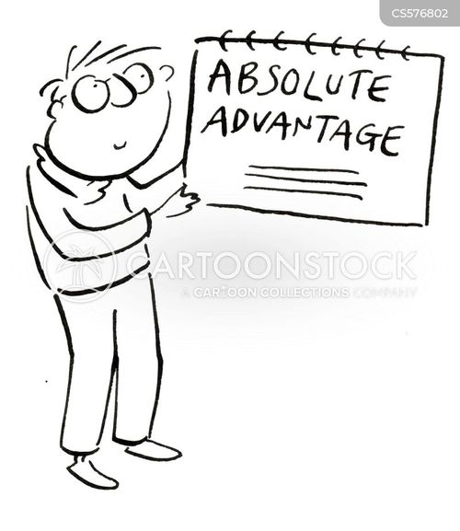
Advantages of solving the issue
Improved financial stability due to better workflow management, cost control, and sustainable profit margins.
Improved scalability and expansion, due to less reliance on a single manufacturing plan.
Greater operational resilience, reducing the risk of future disruptions caused by factory closures or geopolitical tensions.

Slide 31
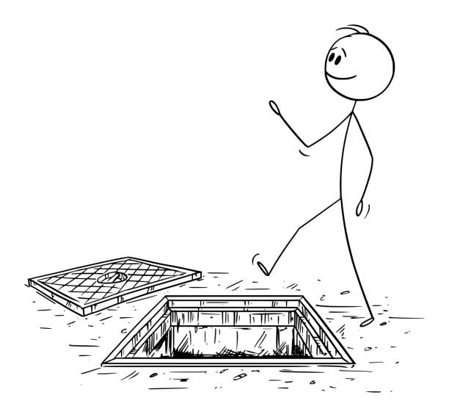
Risks involved in pursuing solutions
Financial risk: Solutions such as establishing a second manufacturing plant, outsourcing manufacturing or making software cloud-base solutions require a high initial investment.
Operational and transition risk: Changing manufacturing processes can disrupt existing supply chain workflows, systems, and processes.
Strategic and execution risk: There is a risk that the selected solution will not deliver the expected benefits if market conditions change or operating costs do not decrease.

Slide 32
Legislation, Policies and Procedures

Slide 33

Relevant Legislation
Financial and Consumer Law
Corporations Act 2001.
Anti-Money Laundering and Counter-Terrorism Financing Act 2006 (AML/CTF
Secured Transactions Act 2009
Competition and Consumer Protection Act 2010
Privacy and Data Security
The Privacy Act 1988
Australian Privacy Principles (PPA

Slide 34


Relevant Legislation
Employment and Performance Management
The Fair Work Act 2009
Digital Security and Cybersecurity
Cybercrime Act 2001

Slide 35

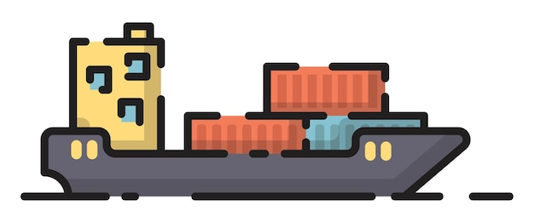
Relevant Legislation
Technical Barriers to Trade (TBT)
The Copyright Act of 1968

Slide 36
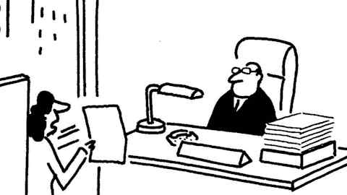
Summary of Policies and Procedures
Finance Authorisation Policy and Procedures
Establishes a mandatory governance framework for all transactions
Procedure:
Approval Authority Credit Card Issuance
Usage Limits
Reconciliation

Slide 37

Summary of Policies and Procedures
Privacy Policy and Procedures
Protecting personal information Based od Australian Privacy Principles (APPs) and the Privacy Act 1988
Procedure:
Data Collection
Physical/Digital Storage
Cyber Prevention

Slide 38

Summary of Policies and Procedures
Performance Management Policy and Procedures
Focuses on procedural fairness, transparency, and professional development.
Procedure:
Review Cycle
Evaluation
Dispute Resolution
Rewards

Slide 39

Summary of Policies and Procedures
Documentation policy and Procedures
Deseing to ensure consistency, version control, and efficient retrieval across the organization.
Procedure:
Standardization
.
Naming Convention
Storage
.
Feedback Loop

Slide 40
Assessment of bias
Perceived
Financial Performance Bias
Excessive focus on revenue growth as an indicator of success, ignoring the impact of rising operating costs.

Slide 41
Assessment of bias
Actual
Operational and Manufacturing Bias
Reliance on a single plant in Hong Kong based on past successes

Slide 42
Assessment of bias
Perceived
Technology and ERP Bias
The current ERP system were sufficient to manage global disruptions.

Slide 43
Resources required for the solution

Slide 44

Human Resources
IT professionals
Supply chain and operations personnel
Finance and management personnel
Trainers

Slide 45

Technological Resources
Improvements ERP system and supply chain management
Software development and scalability
Cybersecurity
Data analysis

Slide 46

Financial Resources
Capital investment to manufacturing solution
Fundings for ERP or cloud solutions
Resources for transition period

Slide 47

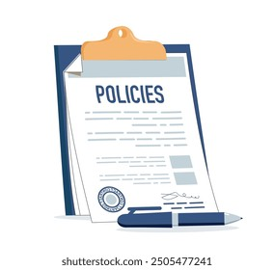
Administrative Resources
Financial Authorization
Privacy
Performance Management
Performance Management

Slide 48
Generating Solutions

Slide 49

Feedback presentation
It's a company that experienced significant growth during the COVID-19 pandemic. This allowed it to raise prices, increase profits, and expand.
The company's social policies may contribute to the problem.
The company is taking too long to resolve its manufacturing plant issue.
Those responsible for tablet supply may have anticipated that the company lacked the capacity to meet demand.

Slide 50

Brainstorming
Accelerate the transition to B2C model
Get partner to offer and pre-installed their software
Build a second
Find local manufacturers
Expand their product catalogue
To abandon product manufacturing and focus on the Software-as-a-Service model

Slide 51
Mind mapping

Slide 52
Alternative solutions
Cloud-First SaaS and B2C Model
Strategic Hardware Partnerships and Outsourced Distribution
Diversified Global Manufacturing Model
Product Portfolio Diversification.

Slide 53
success criteria table
Criteria | 1 Cloud-First SaaS & B2C | 2 Hardware Partnerships | 3 Diversified Manufacturing | 4 Portfolio Diversification
Clarity | Clear scope; focus on software/B2C, reducing hardware reliance. | Defined roles between brand and partners; lower complexity. | Focus on reducing single-source dependency via multiple sources. | Strategy to broaden offerings for individuals and institutions.
Stability | High; reduces exposure to manufacturing/supply chain risks. | Shifts manufacturing and distribution risks to partners. | Spreads risk across multiple regions and suppliers. | Revenue stability through diverse product categories.
Scalability | Extremely High; add users without increasing factory capacity. | Scalable via partner networks without internal expansion. | Moderate; constrained by CAPEX and operational complexity. | Scalable by targeting different segments and markets.
Usability | High; access on any device, anywhere, anytime. | High; ready-to-use devices with pre-installed software. | Indirect; improves product availability and delivery times. | Depends on design; offers customers more choices.
Integration | Connects with ERP, learning platforms, and CRM. | Requires integration with partner systems and licensing. | High ERP demand to manage multiple global suppliers. | Requires adding new product lines to sales/ERP systems.
Profitability | Strongest potential; low OPEX and recurring subscription revenue. | Lower per-unit margins, but reduced logistics/manufacturing costs. | Long-term potential, though initial investment is high. | Improved via diverse streams, though margins vary.

Slide 54
constraints criteria table
Constraints | 1 Cloud-First SaaS & B2C | 2 Hardware Partnerships | 3 Diversified Manufacturing | 4 Portfolio Diversification
Timeframes | Medium timeframe required to design, test, and deploy a cloud-based B2C platform. | Short to medium timeframe depending on partner selection and contract negotiation. | Long timeframe due to factory setup, supplier selection, and operational transition. | Medium to long timeframe to research, design, source, and launch new products.
Cost | Moderate upfront cost for cloud infrastructure, software redevelopment, and cybersecurity. | Lower capital investment than manufacturing, but reduced profit margins per unit sold. | High initial investment for additional facilities and supplier onboarding. | Moderate to high cost depending on product types and sourcing model.
Resources Required | Skilled IT professionals, software developers, cloud architects, and cybersecurity specialists. | Legal, procurement, and partnership management resources; reduced internal manufacturing staff. | Skilled manufacturing workers, supply chain managers, and operations staff. | Product managers, technical specialists, supplier relationships, and support staff.
Manufacturing / Content Production | No manufacturing required; strong capability in software and content development is essential. | Manufacturing is outsourced; software and content production remains in-house. | Requires strong manufacturing and supply chain capability across multiple locations. | Manufacturing capability may need to be expanded or outsourced for new product types.
Design Capability | In-house software designers and developers can be used; external consultants may be required for cloud architecture. | Limited internal design required for hardware; focus remains on software integration. | In-house engineers may manage design, but external consultants may be required for factory setup. | Internal design capability may be limited; external designers or engineers may be required.
Logistics & Storage | Minimal logistics and storage requirements as software is delivered digitally. | Logistics largely managed by partners, reducing storage and transport requirements. | Increased logistics complexity due to multiple manufacturing and distribution points. | Increased logistics and storage requirements due to a wider range of physical products.
Technology | Company website, ERP system, and customer platforms must be upgraded to support cloud access and subscriptions. | ERP and licensing systems must integrate with partner platforms and sales channels. | ERP system must be enhanced to manage multiple manufacturers, suppliers, and inventory locations. | Sales systems, ERP, and support platforms must be updated to handle multiple product categories.

Slide 55

Feasible Options
Cloud-First SaaS and B2C Model
This alternative solution is feasible and strategically aligned.
Strategic Hardware Partnerships and Outsourced Distribution
This alternative solution is feasible as a transitional or complementary solution.

Slide 56

No Feasible Options
Diversified Global Manufacturing Model
This alternative solution is not feasible because the current financial and operational conditions
Product Portfolio Diversification
This alternative solution is not feasible because increase complexity and does not address the primary problem.

Slide 57
Paired Comparison Analysis
Goal Identify which alternative solution genuinely adds the most value according to the analysis of success criteria and constraints.
Criteria | 1: Cloud-First SaaS & B2C | 2: Hardware Partnerships | Winner
Clarity | 2 | 1 | Option 1
Stability | 2 | 1 | Option 1
Scalability | 2 | 1 | Option 1
Usability | 2 | 2 | Equal
Integration | 2 | 1 | Option 1
Profitability | 2 | 1 | Option 1
Timeframe (constraint) | 1 | 2 | Option 2
Cost (constraint) | 1 | 2 | Option 2
Resources required (constraint) | 1 | 2 | Option 2
Manufacturing dependency (constraint) | 2 | 1 | Option 1
Logistics & storage (constraint) | 2 | 1 | Option 1
Technology readiness (constraint) | 2 | 1 | Option 1
 | 21 | 16

Slide 58
Why?
The Cloud-First SaaS and B2C model is the best solution, as it delivers stronger long-term scalability, stability, and profitability while reducing critical manufacturing and supply chain constraints
The best Alternative Solution | 1 Cloud-First SaaS & B2C | 2 Hardware Partnerships
1 Cloud-First SaaS & B2C | X | 1
2 Hardware Partnerships | X | X

Slide 59

assessment of bias
I would prefer to avoid in-house product manufacturing
As my background in IT I prefer technology- and software-based solutions to physical production models.
I evaluated the two viable possible alternatives using defined success criteria and limitations!

Slide 60

The legislation and organizational policy linked
It meets legislative and organisational policy requirements by strengthening:
Data security
Financial governance
Intellectual property protection,
Compliance with employment and consumer laws

Slide 61

the Solution Aligns with Strategic Priorities
The Cloud-First SaaS & B2C solution supports Worlducation’s strategic priorities by improving
Performance
Profitability, accountability
Long-term sustainability

Slide 62

the Solution Aligns with Strategic Priorities
Advantages
Reducing reliance on manufacturing and inventory
Expands reach
Solution strengthens customer relationships
supports the priority of attracting and developing talent

Slide 63

the solution meets the objectives when seeking solutions
1. Eliminates reliance on physical manufacturing by delivering educational software digitally

Slide 64
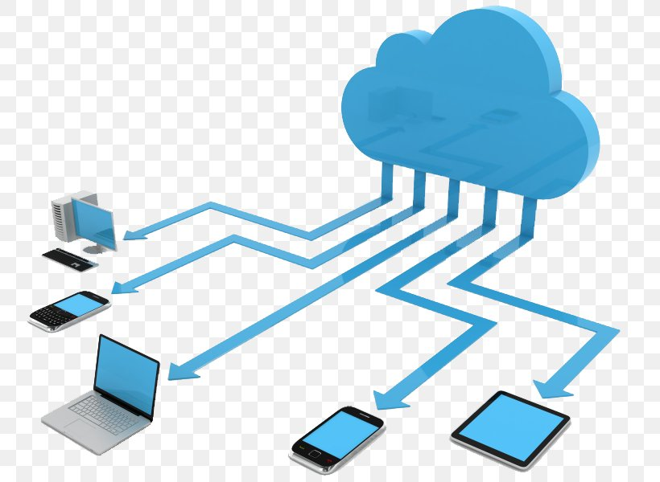
the solution meets the objectives when seeking solutions
2. Cloud-based delivery ensures service continuity regardless of disruptions

Slide 65

Resources Needed
Human Resources
The solution requires qualified
IT
Educational
Technological Resources
Cloud infrastructure
ERP
Website
Cybersecurity

Slide 66

Resources Needed
Financial Resources
Initial investment
Administrative Resources
Administrative resources
Policies
Governance
Legal and compliance

Slide 67
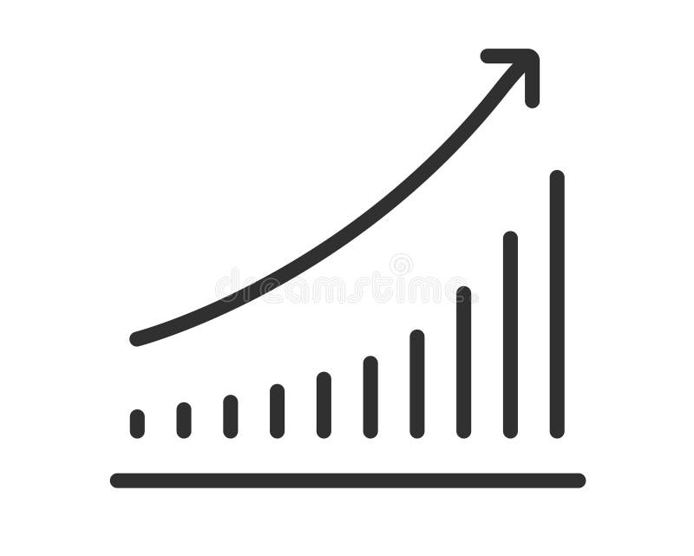
Advantages
Cloud-First SaaS and B2C solution delivers
Operational
Financial
Strategic advantages
Supporting long-term sustainability
Growth

Slide 68
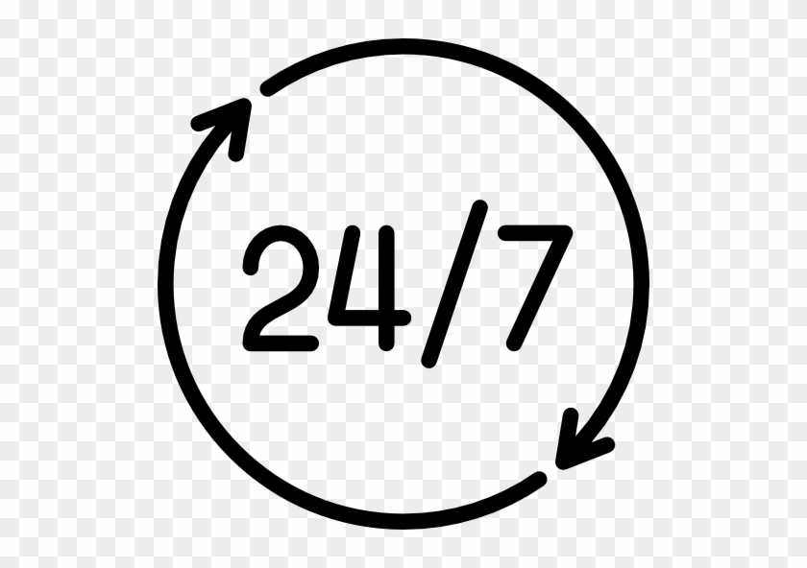
Advantages
Reduced dependence on manufacturing and supply chains
Service continuity and scalability.
Greater financial stability
Greater market reach and accessibility.
The solution can improve the quality and innovation of products and services

Slide 69
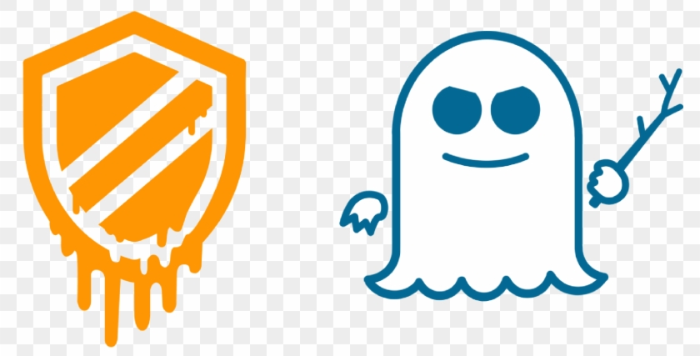
Risks
Cloud-First SaaS & B2C solution presents the inherent risks of any technology
These can be mitigated through strong governance, cybersecurity controls, careful change management, and strategic planning.

Slide 70

Risks
Significant risks to cybersecurity and data privacy.
Risks in implementation and transition.
Financial risks exist during the initial investment phase.
Reliance on third-party cloud service providers.
Customer resistance to change and market adoption

Slide 71
Refine the Project

Slide 72

Feedback register
After analysing the feedback register, the most important points are briefly

Slide 73
Feedback register
Human capital transition and its organizational impact
B2C model
Financial evidence
Root cause & the problem
Explicit support
Sales processes and compensation for the physical product
Operational details

Slide 74
Feedback register
To refine the project objectives, we will consider the following points:
Clarify the scope of the solution
Strengthen the conditions for success
Identify key risks to validate
Adjust the strategic approach

Slide 75
Feedback register
Conversely, the following points are outside the scope of the current project stage:
Define internal processes
Design team structures
Create training plans
Detail sales flows or timelines

Slide 76
Updated Project Objectives
As a result of analysing the feedback register, we have updated the project objectives and provided information describing each one.
Reduce Manufacturing Dependence and Supply Chain Risk
To minimize exposure to factory closures, geopolitical instability, logistical delays, and high inventory costs

Slide 77
Updated Project Objectives
2. Ensure Service Continuity and Scalability
Ensure the continuity of product and service delivery, regardless of manufacturing or shipping disruptions.

Slide 78
Updated Project Objectives
3. Achieve Financial Sustainability and Profitability
Supports the recovery and maintenance of a sustainable net profit margin

Slide 79
Updated Project Objectives
4. Support Organizational Transition Without Compromising Capacity
Acknowledges the business and workforce impacts

Slide 80

Seeking Approval
Subject: Request for Approval – Cloud-First SaaS & B2C Strategic Initiative
To: Senior Management and Founders
CCC: Divya Sapra

Slide 81

Seeking Approval
1. Clarity of the problem and root cause
2. Alignment with business strategy and priorities
3. Financial viability and sustainability
4. Risk management
5. Organizational impact and change management
6. Compliance with legal and internal policies
7. Clear project scope

Slide 82
Thank you
Manuel Perez – MIC 2026

